Slide 1
Bank Marketing Data Set
Analysis Findings

Slide 2
Summary of Problem Statement
Identify data quality and clean data for reporting use.
Determine in advance clients receptive to marketing campaigns.
Identify and evaluate model performance and speak to the evaluation metric used.

Slide 3
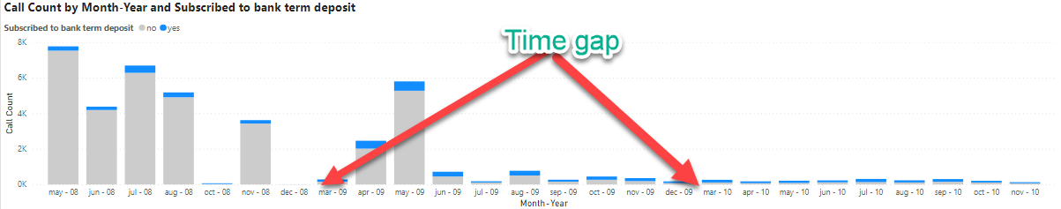
Data Quality - findings
Bank Marketing data is usable in a raw state.
Data is clean with valid inputs
Data file origin – Western European
Date Dimension incomplete, January and February data points do not exist within the data set.
5/21/2021

Slide 4
Data Patterns - Findings
Focused on clients that confirmed subscribing to a term deposit.
Provided model prediction ~50% accurate when targeting a predictive range of 0.8 to 1.0
Alternative evaluation metric, ~58% accurate, focused on Job and Age.
5/21/2021
4

Slide 5
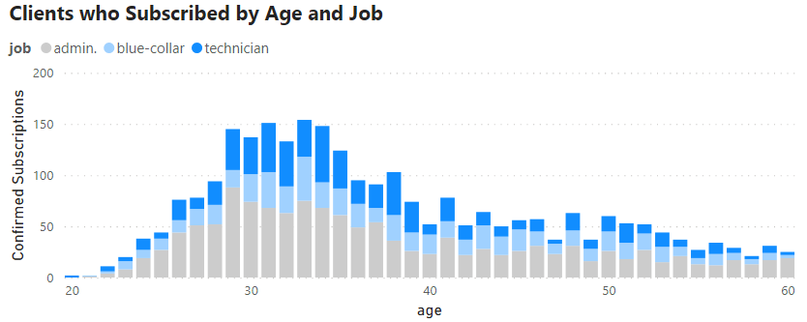
Alternative evaluation metric
~58% ( 2,678 / 4,640 ) clients contacted who subscribed could be found within the following criteria:
Age – between 20 – 60
Job – Admin, Blue-collar, or Technician
5/21/2021
5

Slide 6
Model Evaluation
Current model has limited value yet has potential
With the following improvements the model could be replaced with a more performant solution:
Standard date dimension
Unique value for client identification
Larger dataset
Data validation source to ensure accuracy
Additional research and data exploration should be performed before considering remodeling.
5/21/2021
6

Slide 7

Questions?
5/21/2021
7

Slide 8
Thank you!
Contact Info:
Email – Dan.Walker1990@outlook.com
Phone – 810-434-3595
5/21/2021
8

